Slide 1
Session 3

Slide 2
Content of session
01
02
03
Physics
Tile map
Instantiation

Slide 3
01
Physics

Slide 4
Physics bodies 2D Physics process Physics materials Layers and masks

Slide 5
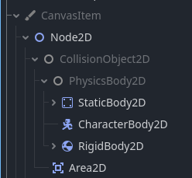
Area 2D
Static body 2D
Rigid body 2D
Character body 2D

Slide 6
Area 2D
Area2D is a node that provides detection data.​
They can emit signals when an object enters or exits with the area’s collision shape, like house who knows who enter and who leave form it.
They are also often used to apply special game effects in certain areas in the game.
It’s position can be changed (moving with the player)

Slide 7
Static body 2D
They are collision bodies that are not moved by the engine.
It is used in collision detection and useful to get and transmit information.
They are used for objects that will not change position in the environment (like walls and floor).

Slide 8
Rigid body 2D
Simulates 2D bodies that moves with physics.
Rigid body does not move by itself, it moves with applying force or impulse with the code.
The Physics engine calculates where and how it’ll move.

Slide 9
Character body 2D
It is a body that provides collision detection, but no physics.​
All physics must be implemented through code.
It moves with the code (like in player or enemy)

Slide 10
What is the difference between rigid body 2D and character body 2D ?

Slide 11
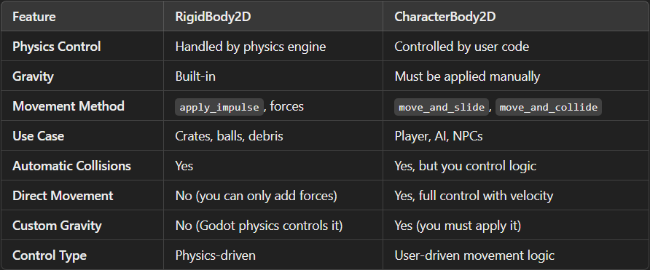

Slide 12
When to use each one of them ?

Slide 13
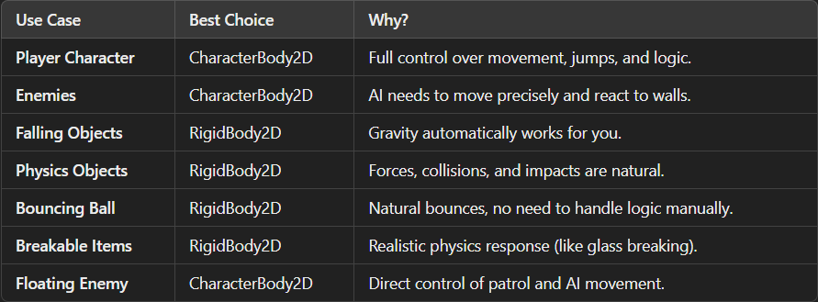

Slide 14
Physics process Physics materials Layers and masks

Slide 15
The physics engine runs physics process function with stable frame rate (60 per second) and this make the game’s physics and collisions runs with stable frame rate and this keep the performance of the game same on any system, different from the process function that run with frame rate based on the user’s resources.
Physics process

Slide 16
What is Delta ?

Slide 17
Delta -> it is the time of creating one frame in the game.
What is Delta ?

Slide 18
Why should we use Delta ?

Slide 19
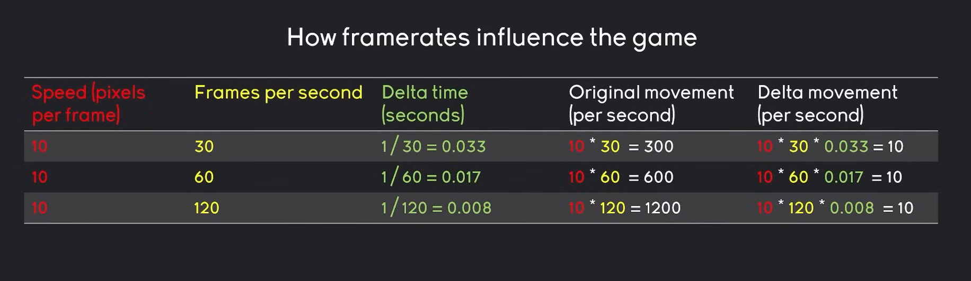
Why should we use Delta ?

Slide 20
Physics materials Layers and masks

Slide 21
Physics materials
Friction: Determines how much two objects slide against each other when they are in contact.
Bounce: Controls how much an object will bounce off another object upon collision.
Rough: If enabled, the object will have a rough surface, affecting how it interacts with other objects.
Absorbent: If enabled, the object will absorb some of the impact force during collisions.

Slide 22
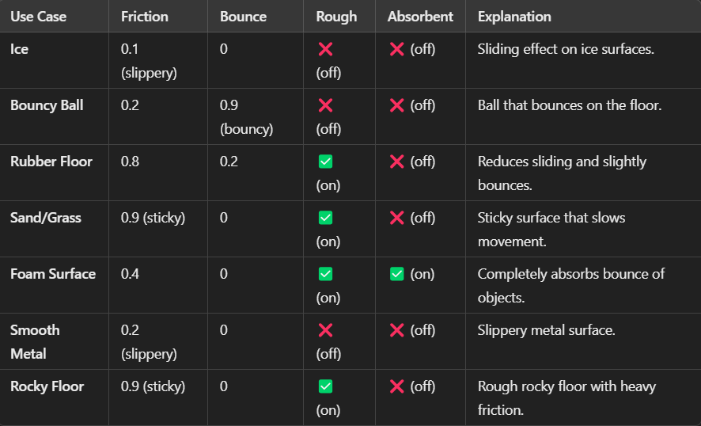

Slide 23
Layers and masks

Slide 24
Layers -> the layers which the collision body is in. masks -> the layers that the node can interact or collide with
Layers and masks

Slide 25
02
Tile map

Slide 26
1. Insert tile map layer node 2. Create tile set 3. Drag and drop tile set image 4. make sure every tile is correct 5. open tile map and start painting
Tile map

Slide 27
Now, make your Tile Map

Slide 28
03
Instantiation

Slide 29
Instantiation
Whenever you’re playing a game often you see a lot of objects in the game world interacting with you, some appear on certain events and some and disappear after certain actions.
It’s not realistic to have all these objects stored in memory all the time, as it will deplete all our resources (RAM).
So, we use instantiation.

Slide 30
What is Instantiation ?

Slide 31
What is Instantiation ?
Instantiation (or instancing) lets you make new instances of a node or scenes during the game’s runtime. This implemented through code.
For example, If I’m playing a game building houses, When I click with my mouse on a piece of land, a house will appear. But how?
Here, on the button’s action, we will make a new instance of the house and place it.

Slide 32
How to make instances ?

Slide 33


How to make instances ?
Need reference for the scene we want to make new instances of.
Use preload() function to load the scene into variable.
Make new variable with the instance, using instantiate() function.
Add the new instance to as a child for the tree root, using add_child() function.

Slide 34
Thanks!
Any Questions

